Slide 1
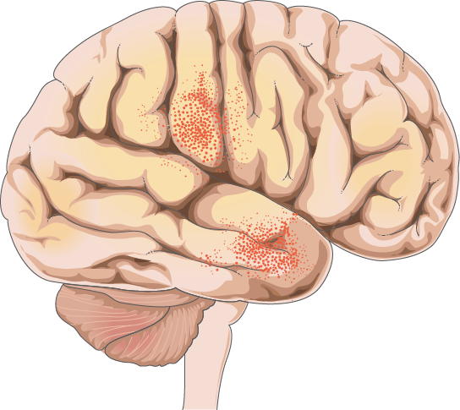
🧠VecTorium
Brain Tumor Classification
0001

Slide 2
Table of contents
01
02
03
0002
Introduction
Motivation
Problem Statement
04
05
06
Literature Survey
Dataset Statistics
Proposed Methodology
07
08
09
Results And Analysis
References
Conclusion And future Work

Slide 3
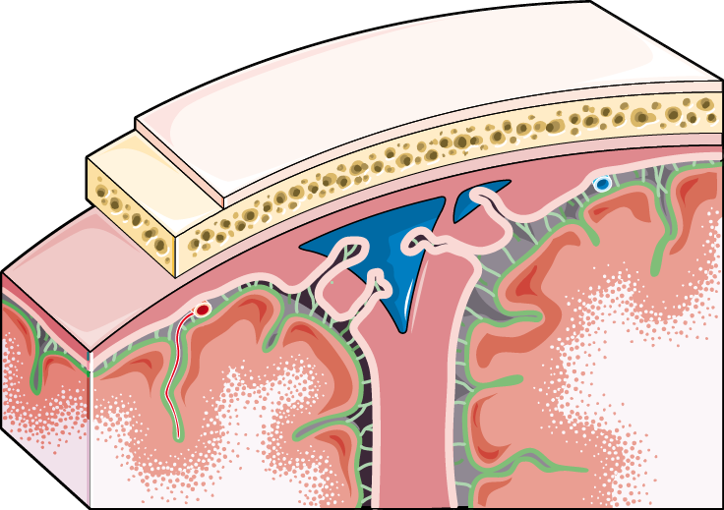
01
Introduction
0003

Slide 4

VecTorium: A Novel Ensemble Model for Brain Tumor Classification
0004
Challenge: Accurate and timely diagnosis of brain tumors is critical for effective treatment.
Solution: VecTorium combines EfficientNetB3, VGG16, and ResNet50 to create a robust feature space using feature-level integration.
Key Features: >High classification accuracy. >Unified pipeline with reduced computational complexity.
Impact: Enhanced diagnosis and improved treatment outcomes for patients.

Slide 5
02
Motivation
0005

Slide 6

Motivation
0006
Critical Need: Accurate and timely diagnosis of brain tumors is essential to improve survival rates and guide effective treatment.
Limitations of Traditional Methods: Single-model approaches may lack robustness, and traditional ensemble methods can be computationally intensive.
Our Solution: VecTorium integrates pre-trained models (EfficientNetB3, VGG16, ResNet50) at the feature level, enabling:
Easier Training: Unified dense layers reduce the complexity of traditional ensemble training.
Enhanced Efficiency: Single-pass inference minimizes computational costs while maintaining high accuracy.
Robust Classification: Diverse architectural strengths combine to create a richer feature space for better performance.

Slide 7
03
Problem Statement
0007

Slide 8
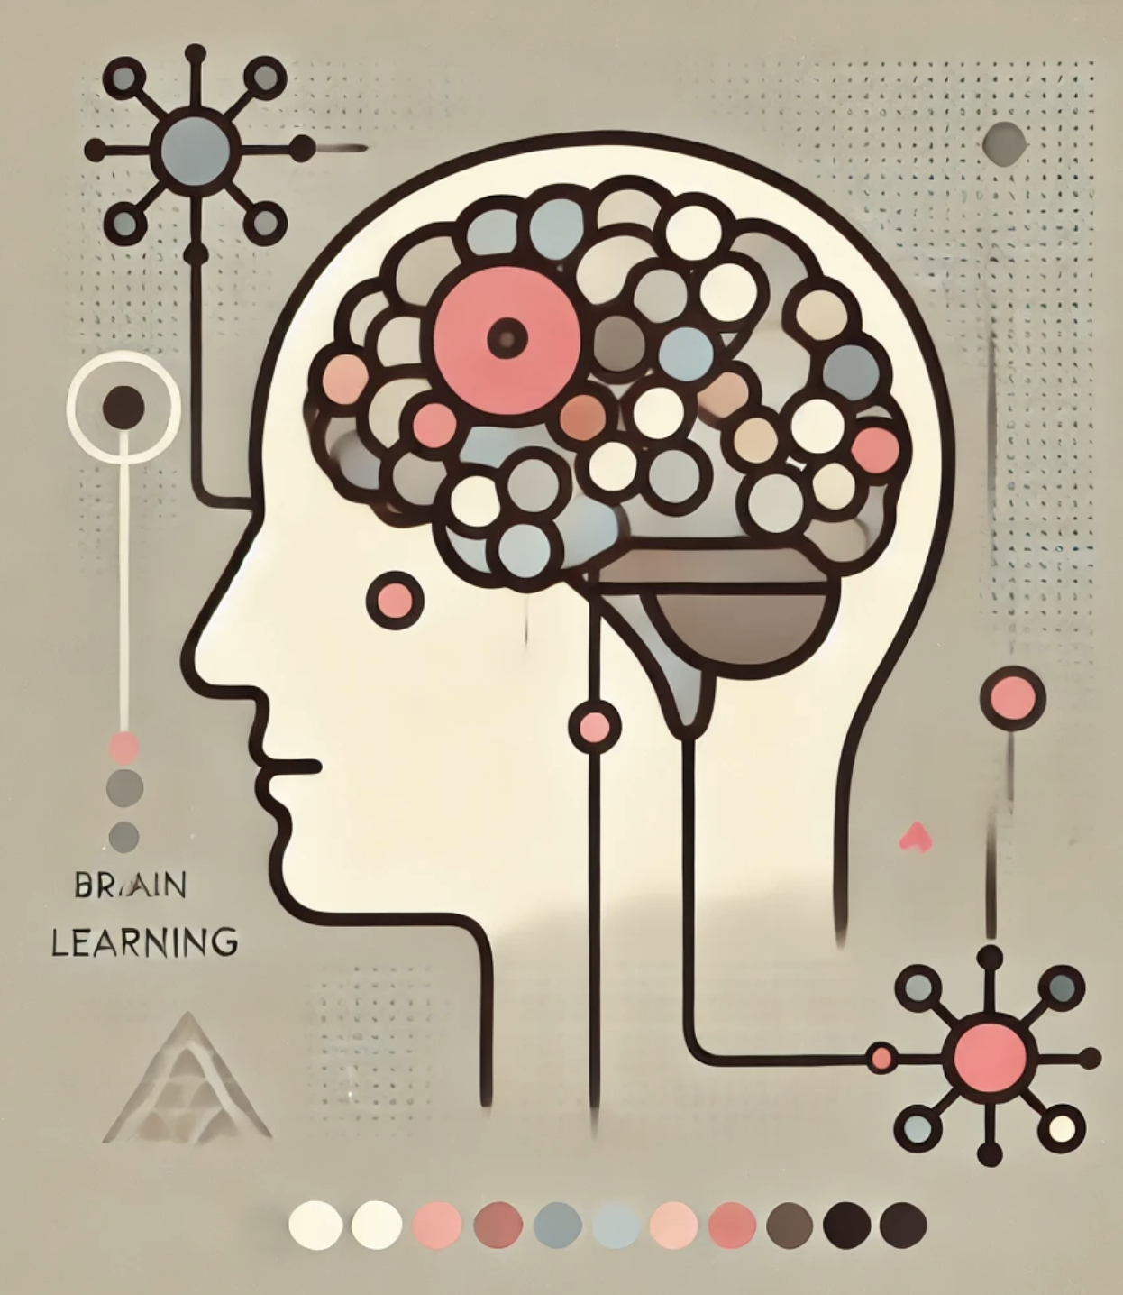
Problem Statement
0008
Challenge: Accurate classification of brain tumors is essential for effective treatment but is hindered by: >Complex and diverse tumor patterns.
>Variability in tumor types, sizes, and imaging modalities.
2. Our Goal: To build a robust model that:
>Reliably classifies various brain tumor types.
>Leverages feature concatenation from
efficientNetB3, VGG16, and ResNet50 to enhance
diagnostic credibility.
> Simplifies training while maintaining computational
efficiency and high accuracy.

Slide 9
04
Literature survey
0009

Slide 10
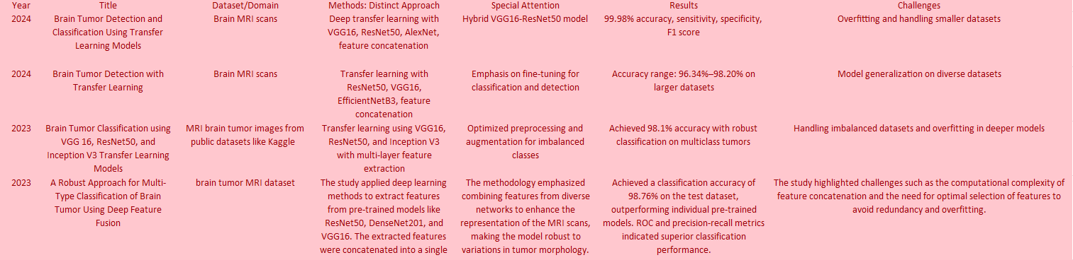
Comparative Analysis of Existing Approaches
0010

Slide 11
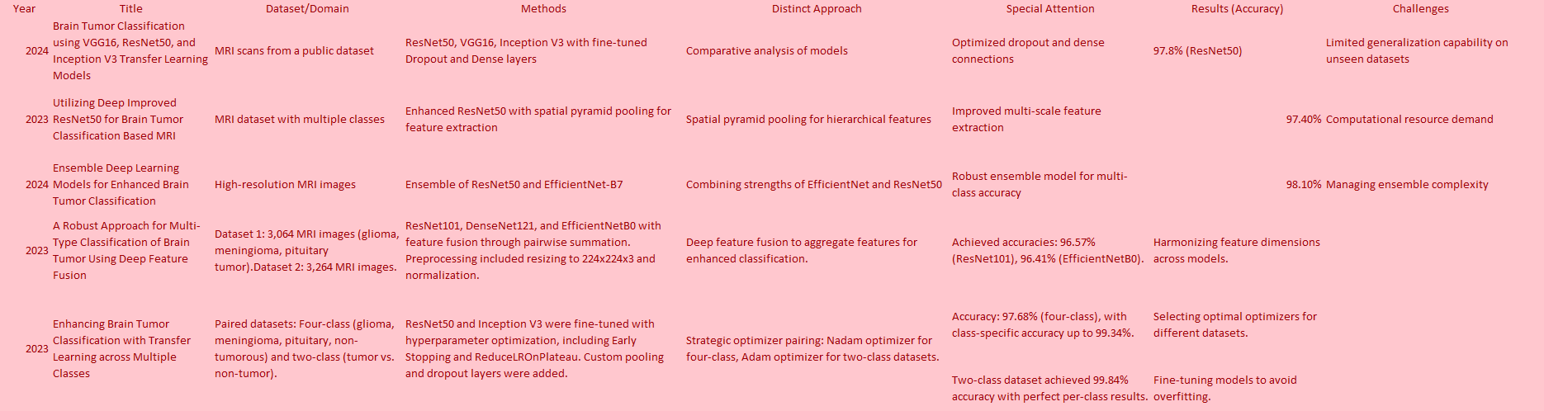
Comparative Analysis of Existing Approaches
0010

Slide 12
05
Dataset Statistics
0011

Slide 13
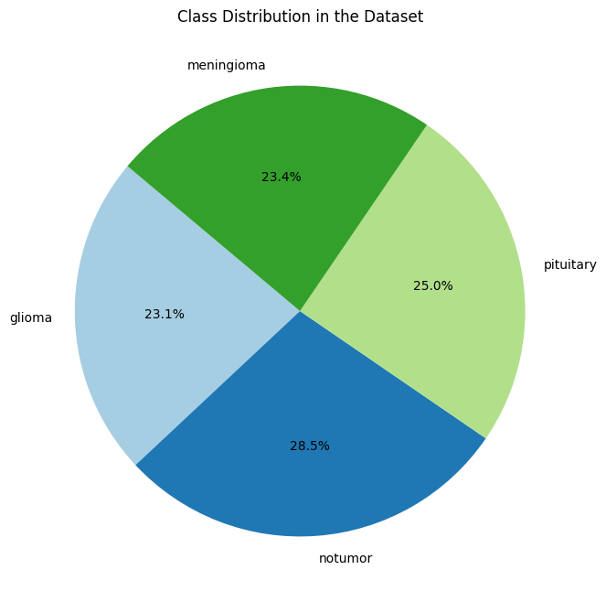
Dataset Statistics: Class Distribution
0012
Class Imbalance: The dataset shows slight imbalances across the four classes:
> Meningioma: 23.4%
> Pituitary: 25%
> Glioma: 23.1%
> No Tumor: 28.5%
2. Impact: Although the distribution is not perfectly balanced, the variations are minimal, allowing the model to generalize well.

Slide 14
06
Proposed Methodology
0013

Slide 15
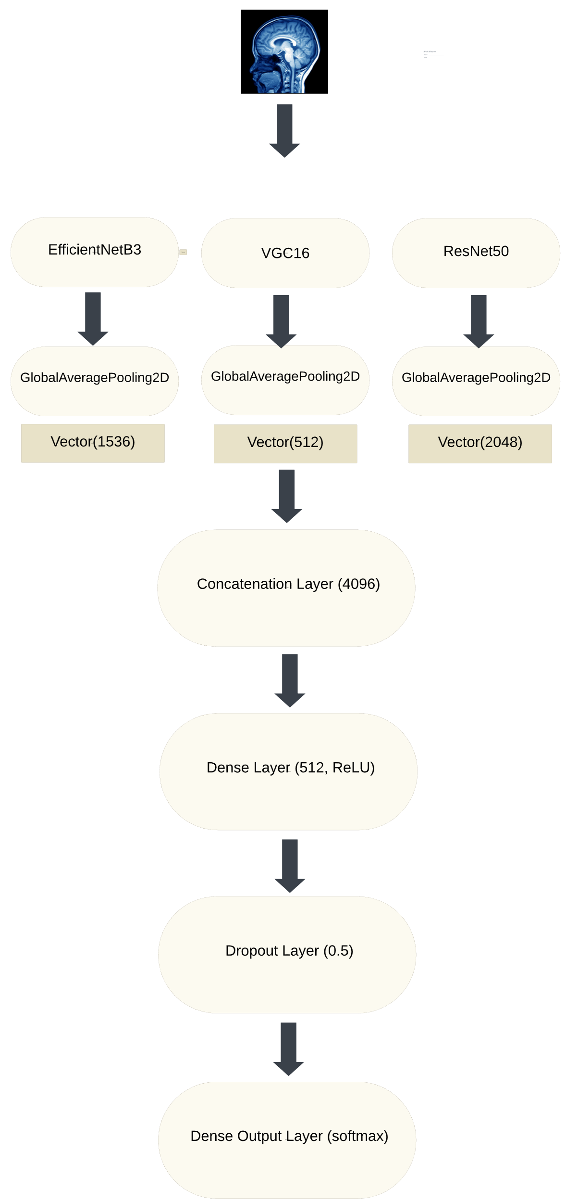
Feature Fusion Model with Pre-Trained Networks
0014
Combines features from three powerful pre-trained models: EfficientNetB3, VGG16, and ResNet50.
Key Steps: > Extract features using base models
> Apply Global Average Pooling (GAP) to reduce spatial
dimensions
> Concatenate feature vectors into a unified
representation
> Use dense layers to refine the combined features
> Output predictions with a softmax layer

Slide 16
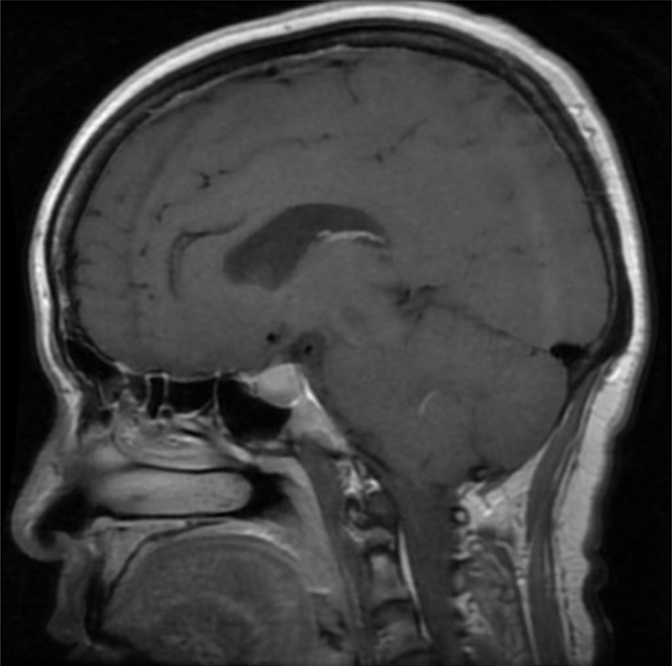
Input Image
0015
Accepts an RGB image with shape (H,W,3)(H, W, 3)(H,W,3), where HHH and WWW are predefined dimensions.
Purpose: Prepares the data for processing by ensuring compatibility with the pre-trained models.
Key Point: Acts as the entry point for feature extraction pipelines.

Slide 17
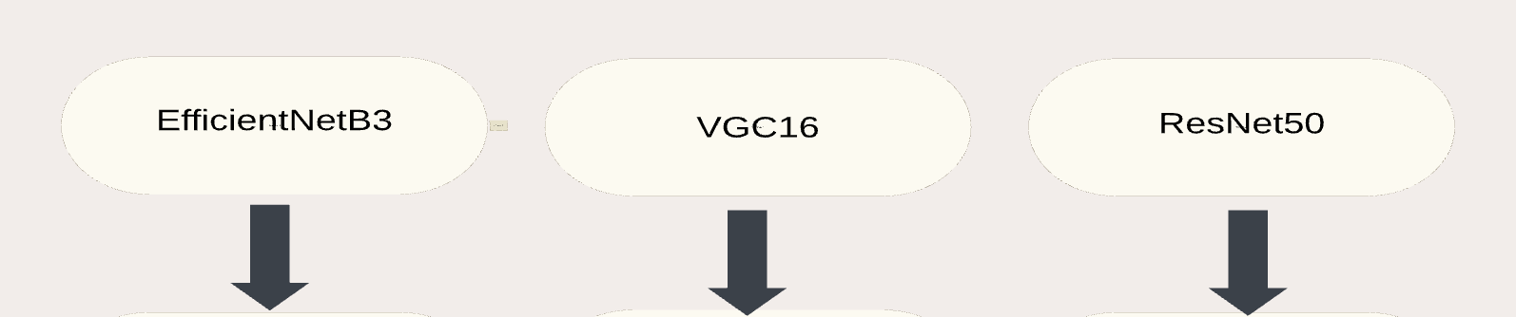
EfficientNetB3, VGG16, ResNet50
0016
EfficientNetB3: Optimized for efficiency, extracts semantic features with minimal computational cost.
VGG16: Extracts spatial and textural features through its deep convolutional architecture.
ResNet50: Uses residual learning to avoid gradient issues and capture hierarchical features.
Key Role: Each model generates distinct feature representations of the input image.

Slide 18
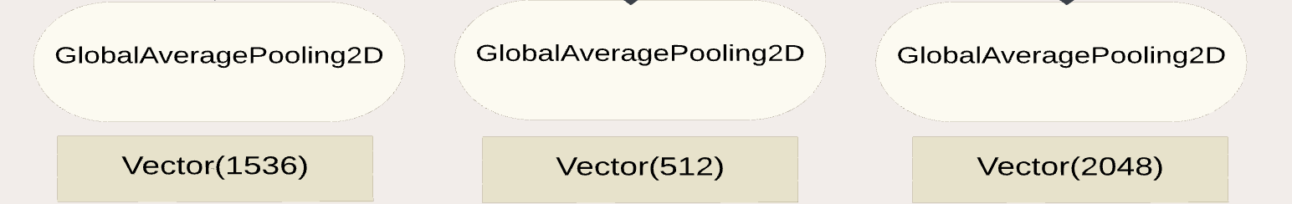
GlobalAveragePooling2D and Feature Vectors
0017
Function: Reduces the spatial dimensions of feature maps by averaging values for each channel.
Output Vectors:
EfficientNetB3 → 1536-dimensional vector.
VGG16 → 512-dimensional vector.
ResNet50 → 2048-dimensional vector.
Purpose: Converts feature maps into compact, dense vectors while retaining essential information.

Slide 19
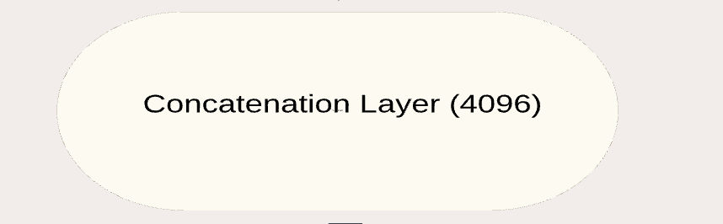
Feature Vector Concatenation
0018
Function: Combines the three feature vectors into a single 4096-dimensional vector.
Role: Aggregates diverse features from all models to form a unified representation.
Advantage: Provides a richer and more comprehensive feature space for classification.

Slide 20
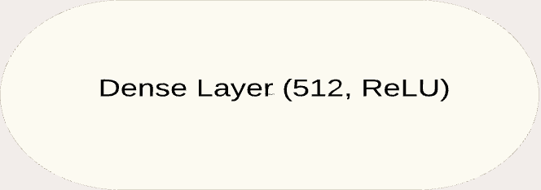
Fully Connected Dense Layer
0019
Structure: Contains 512 neurons with ReLU activation.
Purpose: Refines the concatenated vector by learning weighted combinations of the features.
Key Point: Adds non-linear transformations to enhance the model's learning capacity.

Slide 21
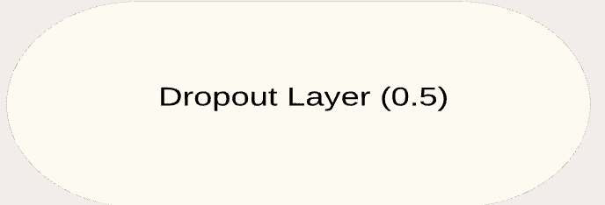
Dropout for Regularization
0020
Function: Deactivates 50% of the neurons during training to prevent overfitting.
Purpose: Improves model generalization and robustness.
Key Role: Ensures the dense layer does not memorize training data.

Slide 22
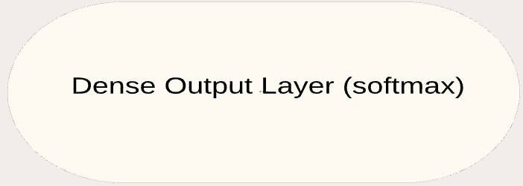
SoftMax Classifier
0021
Structure: Dense layer with CCC neurons (one for each class) and softmax activation.
Function: Converts the refined vector into class probabilities.
Purpose: Provides normalized scores for multi-class classification.
Key Point: Ensures the model outputs interpretable predictions.

Slide 23
07
Results And Analysis
0022

Slide 24
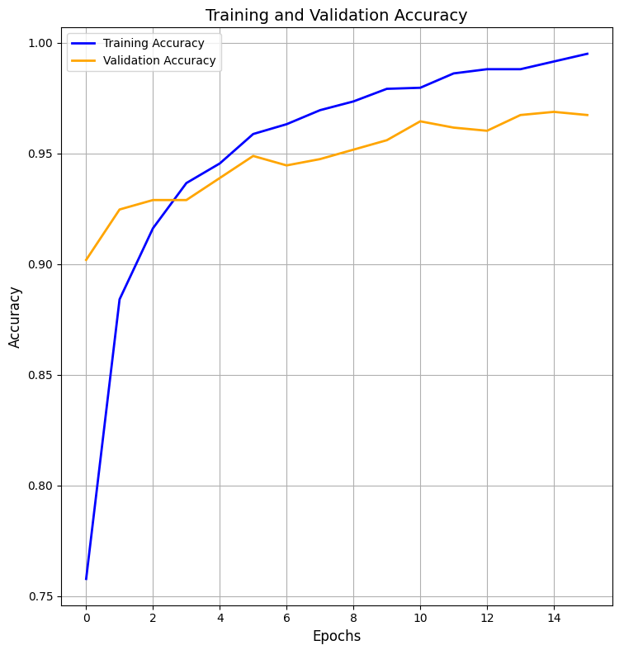
Model Training and Validation Accuracy
0023
Overview:
The plot demonstrates the model's accuracy on the training and validation datasets over 15 epochs.
Training Accuracy (Blue Curve):
Validation Accuracy (Orange Curve):
Insights:
Model is learning effectively, showing continuous improvement in accuracy.
Validation accuracy aligns closely with training accuracy, indicating good generalization.

Slide 25
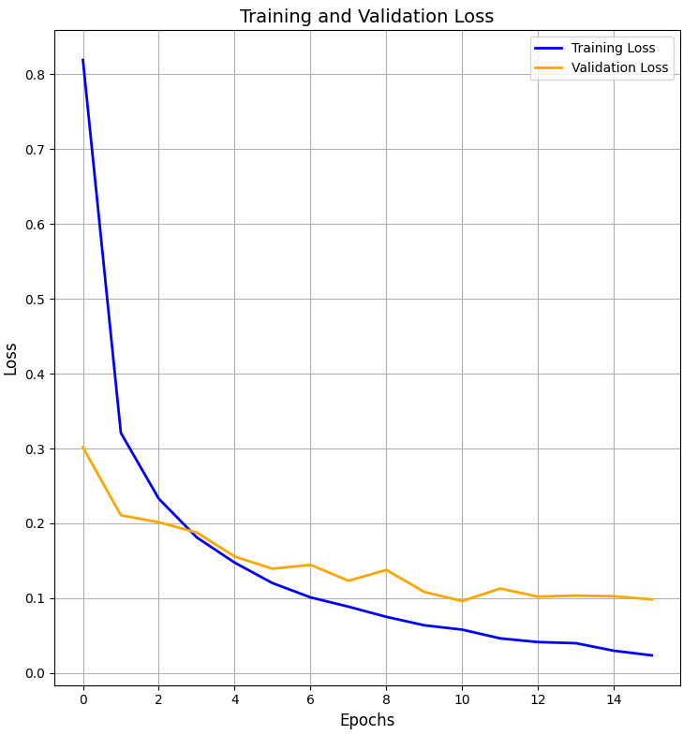
Model Training and Validation Loss
0024
Overview:
The plot shows the model's loss on the training and validation datasets over 15 epochs.
Training Loss (Blue Curve):
Validation Loss (Orange Curve):
Insights:
Model is minimizing prediction errors effectively over time.
Loss fluctuations in the validation set indicate areas for potential refinement.

Slide 26
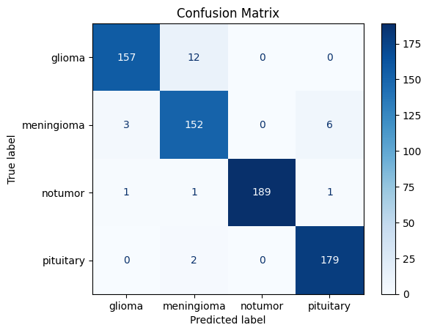
Confusion Matrix Analysis
0025
Interpretation: The model is highly accurate in classifying the different categories, as indicated by the high numbers on the diagonal.
Model Strength: The model performs well in distinguishing between glioma, meningioma, notumor, and pituitary.
Areas of Improvement: The off-diagonal numbers highlight some misclassifications, suggesting potential areas for further refinement.

Slide 27
Ablation Report
0025
*At 10 epochs
🧠 | VecTorium | EfficientNetB3 | VGG16 | ResnNet50
Accuracy | 0.9695 | 0.9023 | 0.9261 | 0.9369
Loss | 0.0848 | 0.2427 | 0.2208 | 0.1782
Test Accuracy | 96.44% | 90.47% | 91.89% | 93.46%
Test Loss | 0.0962 | 0.2464 | 0.2371 | 0.1799

Slide 28
08
Conclusion And Future Work
0026

Slide 29
Conclusion
0027
1. Superior Performance of VecTorium
>Highest Accuracy: 96.95%
>Lowest Loss: 0.0848
>Best Test Accuracy: 96.44%
>Lowest Test Loss: 0.0962
2. Comparison with Standard Models
>EfficientNetB3: Lower accuracy 90.47% and higher test loss 0.2464.
>VGG16: Moderate performance with 91.89% test accuracy and 0.2371 test loss.
>ResNet50: Competitive with 93.46% test accuracy but still outperformed by
VecTorium.
3. Conclusion
>Unlike traditional ensemble methods that combine model predictions, this
approach concatenates feature representations from multiple models and trains a
shared classifier on these combined features. It provides a more integrated and
efficient solution for leveraging the strengths of multiple architectures.

Slide 30
Future Work
0027
Model Optimization
>Enhance VecTorium’s efficiency for real-time applications.
>Reduce computational requirements for broader accessibility.
2. Expanded Applications
>Test VecTorium on larger, diverse datasets.
>Explore its adaptability for other domains and tasks.

Slide 31
09
References
0028

Slide 32
Photos
Woman with headache in studio
Unrecognizable woman with aching neck
Photo woman touching sore neck
Woman with headache in office

